Slide 1

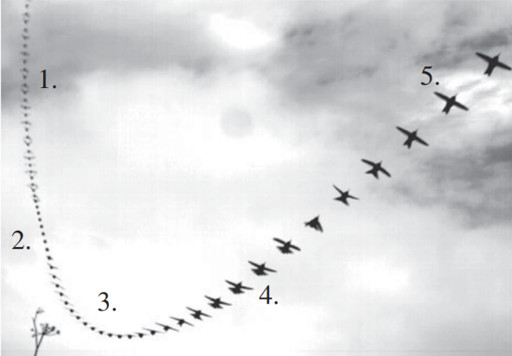
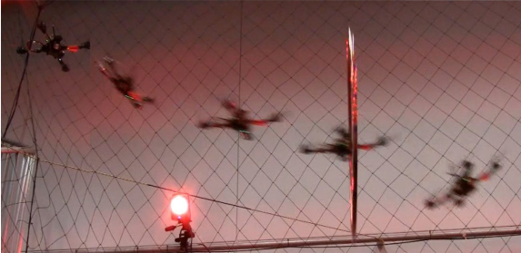
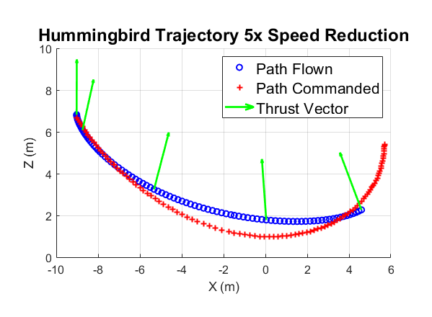
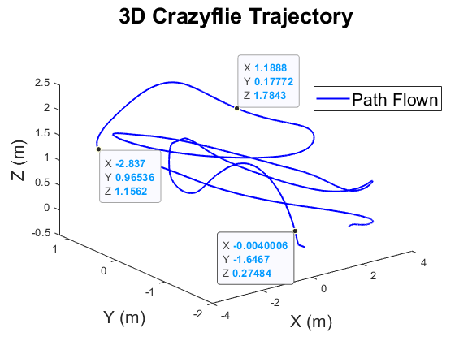
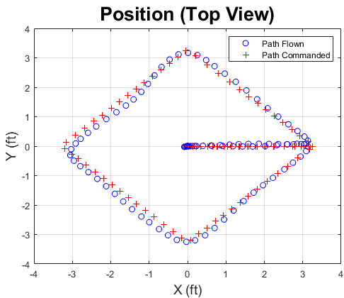
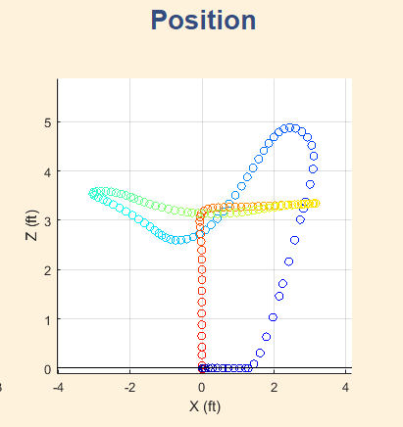
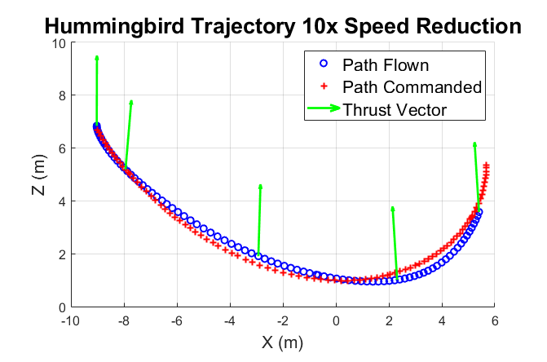
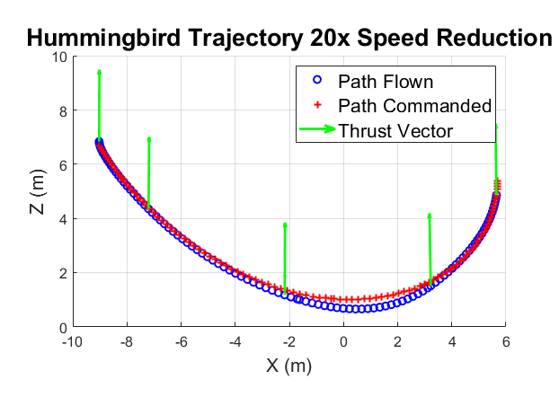
Autonomous Trajectory Planning to Copy Bird-like Maneuvers
MIDN 1/C Ethan Marcello and Prof. Dennis Evangelista
Motivation
Methods
Results
Trial | RMSE (cm) | Lgst Deviation (cm)
1/5 | 560 | 5
1/10 | 50 | 6
1/20 | 50 | y
Animals moving in complex environments are an excellent source of inspiration for improving robots. This project is inspired by the extreme maneuverability of the male Anna’s Hummingbird (Calypte anna). I hope to make use of the study of their phenomenal dive maneuvers to test the limits of quadrotor control at high speeds and torques. Successful research will enhance our high-speed control ability of quadrotor drones to increase their usefulness and application in the public and private sectors.
Simulation (MATLAB Simulink):
Rigid Body Model:
Body Properties: Crazyflie modeled from bitcraze website and measurements taken by calipers.
Hover condition assumed for control, with pitch and roll angles linearized about an operating point of zero degrees. Attitude angle command saturation limits at +/-12 degrees.
Controller: Position Controller with PID control.
Three trials were run at varying speed reductions using the same PID controller used to fly the diamond pattern in Figure 2. The attitude angle command saturation limits were increased to +/-25 degrees. The simulated quadrotor was able to follow the one twentieth speed reduction the closest, and had the smallest RMSE, while the trial at one fifth the speed was incredibly slow.
Table 1: The RMSE and largest deviation between trajectory paths for each trial.
Hardware Testing
Source: Velodyne Inc.
Figure 1: (a) The five stages of an Anna’s Hummingbird dive maneuver, from [Clark 2009]. (b) A quadrotor using an aggressive path planning algorithm to fly through a thrown hoop, from [Kumar YYYY]
Problem Statement
Given a representative C. anna trajectory, a quadrotor MATLAB Simulink simulation, a Bitcraze Crazyflie 2.1, and an optical motion tracking system (OptiTrack), a suitable controller will be developed to fly a quadrotor autonomously to mimic a scaled-down representative hummingbird dive trajectory. Attempts will first be made in simulation, and then in proof of concept demonstration. Successful trials will demonstrate a root mean square error (RMSE) between the desired trajectory and the actual trajectory of less than 10cm with a 5cm standard deviation over the entire dataset. These errors will be calculated between the x,y,z position data for each pair of data points with the same time stamp. (other assumptions?)
Figure 5: 3D position data of a manually-controlled flight with the Crazyflie, captured with OptiTrack, and plotted in MATLAB.
Figure 2: (a, b) Simulated quadrotor flying a commanded “Diamond” trajectory in the X-Y plane, while attempting to maintain a 1m hover.
Hardware testing for the autonomous Crazyflie flight was successful in obtaining 3D position data from the Crazyflie. The next step is to obtain data from an autonomous flight using a basic position controller as in the simulation. Additionally, the trajectory controller will undergo basic tuning, consider saturation limits and incorporate additional linearization regions of control for different stages of the dive.
Proof-of-Concept Demonstration:
ROS on linux machine sends commands to Crazyflie and obtains sensor data from Crazyflie, and x,y,z position data from the OptiTrack
OptiTrack Motion Tracking System accurate to +/- 0.5mm
References
Related Work
<<<Pic here of drone flying w/ OptiTrack in background>>> Also point to important stuff using art/arrows
[1] W.-K. Chen, Linear Networks and Systems. Belmont, CA: Wadsworth, 1993, pp. 123–135. (book example, omit page numbers if needed)
(use IEEE format): cite Clark, Kumar, M. Grieff (control) and the simulation people.
Short mention of work in Grieff and Kumar.
Acknowledgement
Figure 3: Annotate photo with labels and arrows
Figure 4(a,b,c): Simulated Crazyflie flying the true Hummingbird trajectory at one fifth, one tenth, and one twentieth the actual Hummingbird’s speed.
Professor Chris Clark (trajectories), Professor Cheng, Professor Dawkins, Professor Piper, 2ndLt Canlas, MIDN Guinan
Notes:
Do not change: page size, background color, font size or font type
You may change: the name of the section headings as appropriate (e.g. Method might be Algorithm, Design Approach or Analysis); You may also remove a section if it doesn’t apply (e.g. Acknowledgements)
Tips:
Graphics should be hi res (will be printed large), captioned, and source listed in caption or on graphic if not self generated. Use white outline. Png is a good file format for matlab plots. Jpg preferred for photos
Plots: make sure fonts for axis labels are readable. Consider adding axis labels or annotations in power point rather than generating software.

